Slide 1
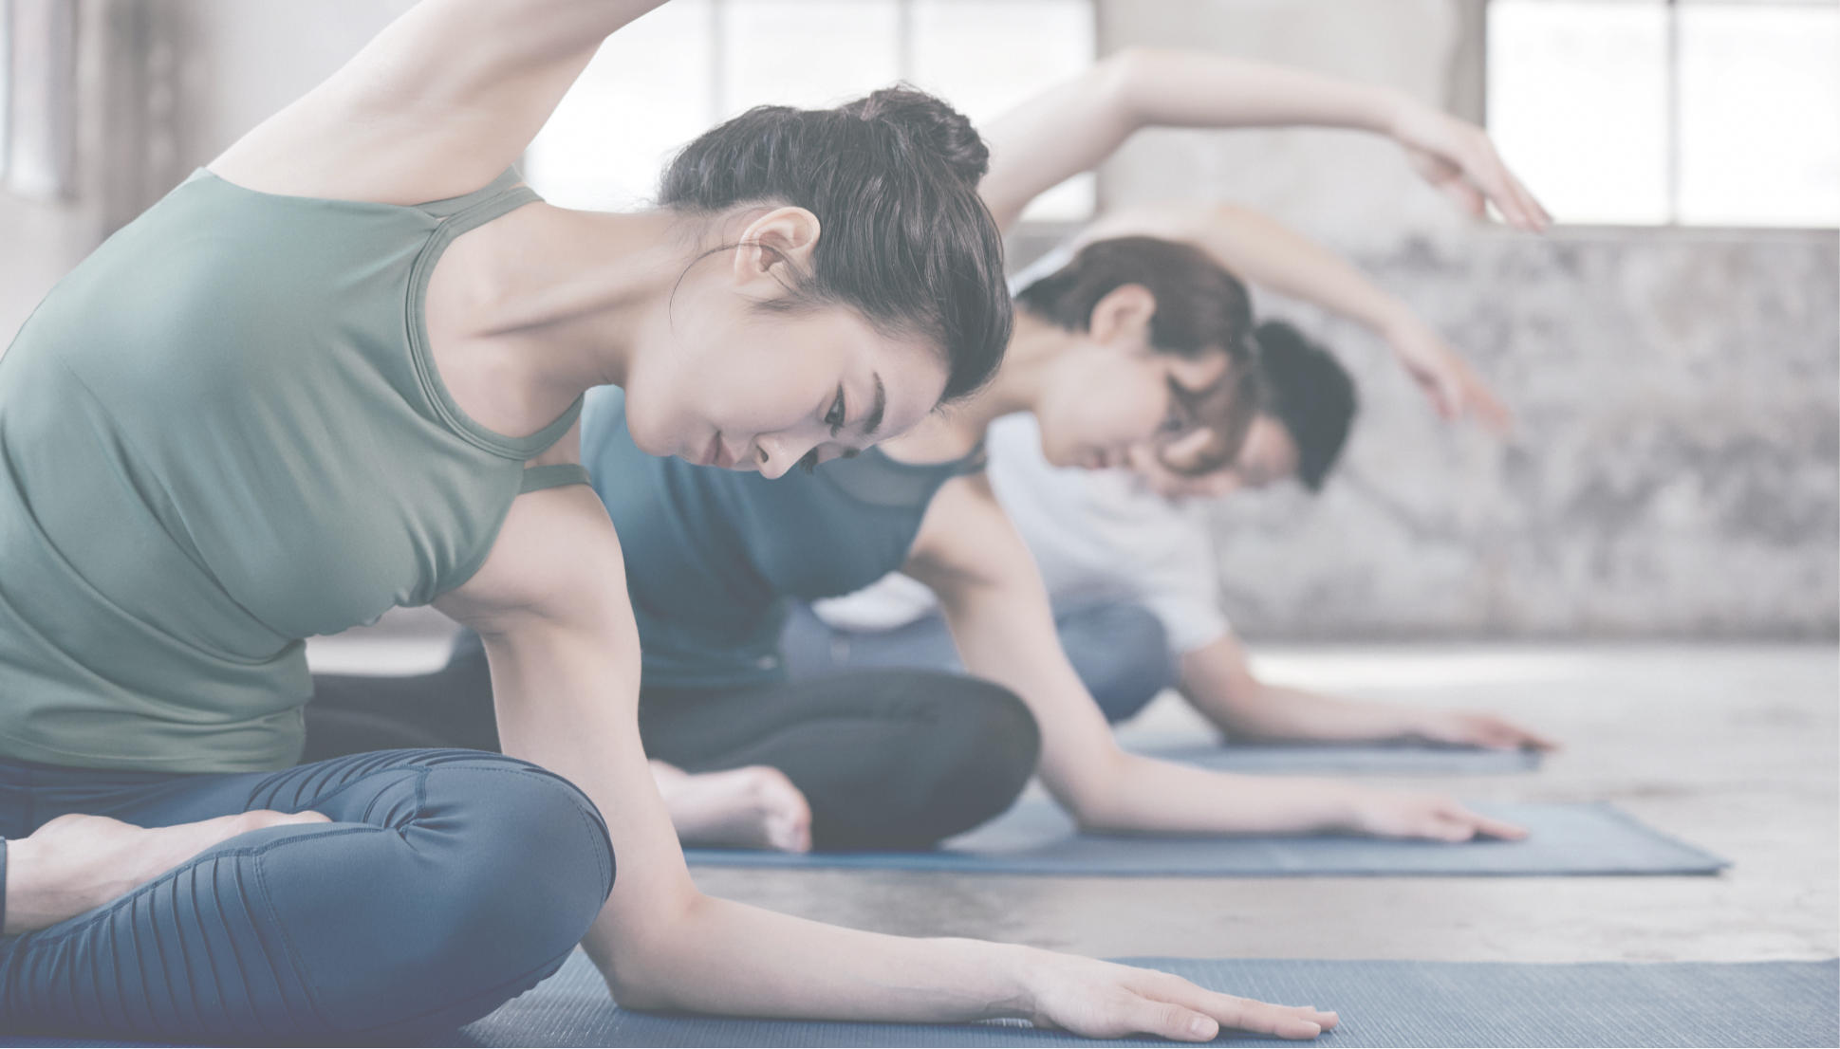


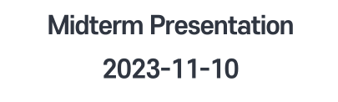

Notes:
Hello I’m Jaehyun Song from team M.
This is our Midterm presentation.

Slide 2
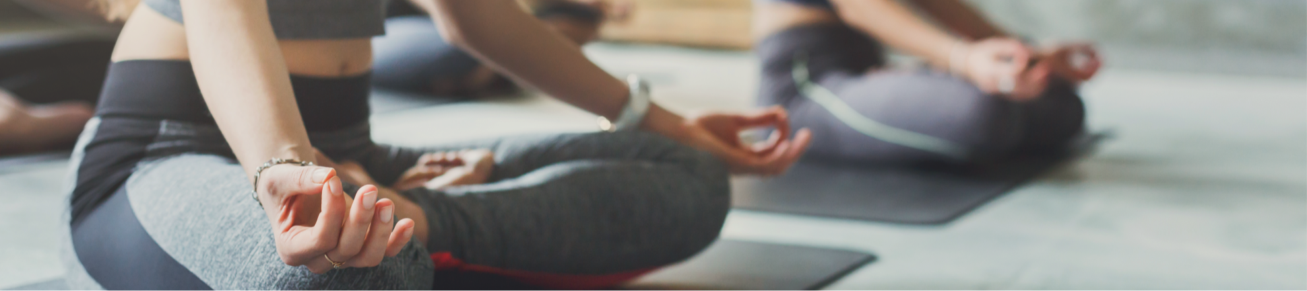
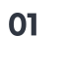
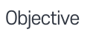

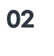
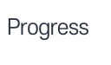
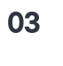
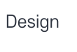
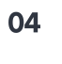
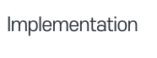
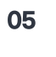
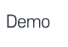
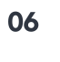

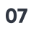
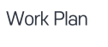
Notes:
I go through our entire project so far like objectives to our challenges we’ve met until now.

Slide 3



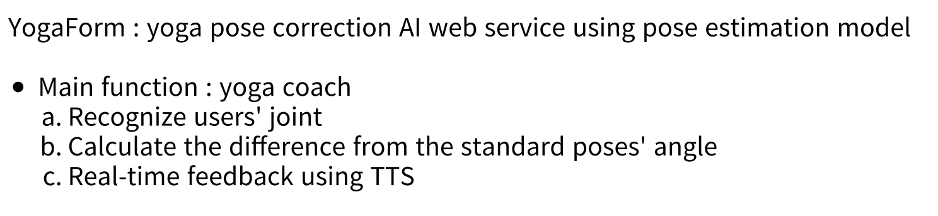
Notes:
When you do yoga alone, it’s hard to tell if your posture us correct doing yoga alone.
So we proposed our yogaform, yoga pose correction AI web service using pose estimation model.
The main service is yoga coach. It will recognize user’s joint, and calculate the difference from the standard poses’ angle.
Whether user should stretch more or bend more shall be provided in speech.
This is our core function, and now I’ll illustrate how hard we did till this week and how much we achieved.

Slide 4


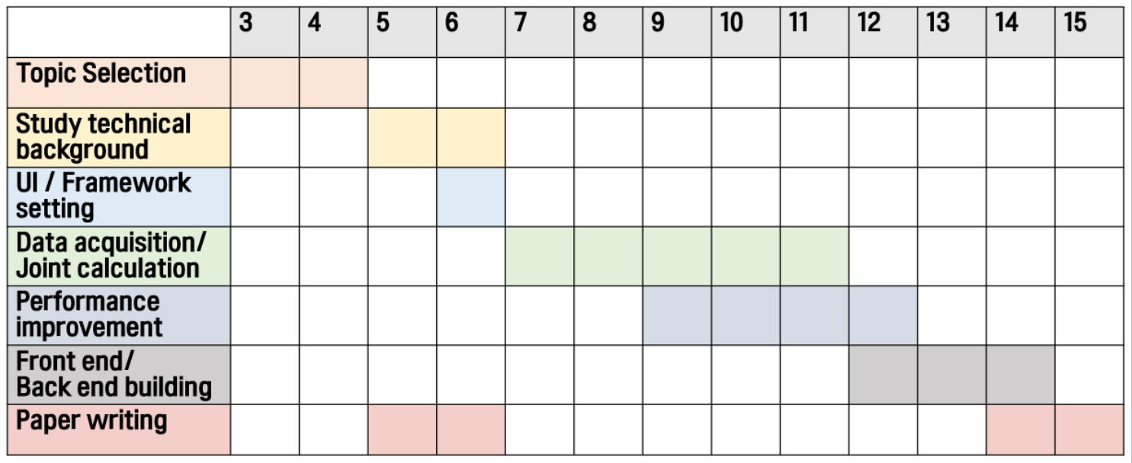
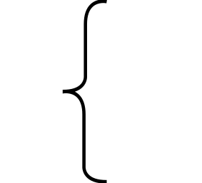


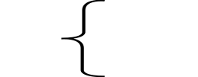
Notes:
This is our planned work schedule. Ans we’re on week 11.
Till this week we managed to complete top four tasks.
About UI and Framework setting, I’ll show you in a minute.
We finished joint calculation, and we already showed in this class previously.
We’re now immensively working on development, because we found loads of tasks ahead.
Until today, we had 11 team meetings, and all of our meetings and works are saved on Notion and github.

Slide 5







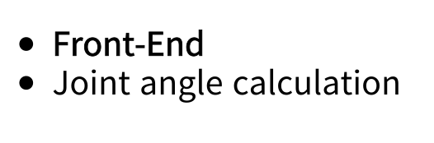
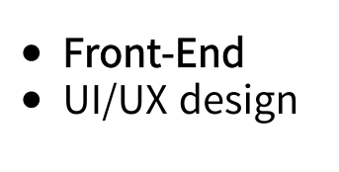
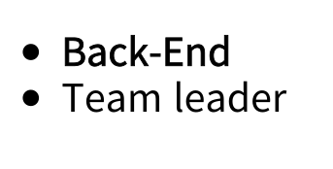
Notes:
Our group consists of 3 people, and your can tell which one is me at a glance.
혜인 is working on Front-end and in charge of joiint angle calculation.
유하 is also working on frontend and in charge of UI’UX design.
I’m working on backend and in charge of presentation.

Slide 6

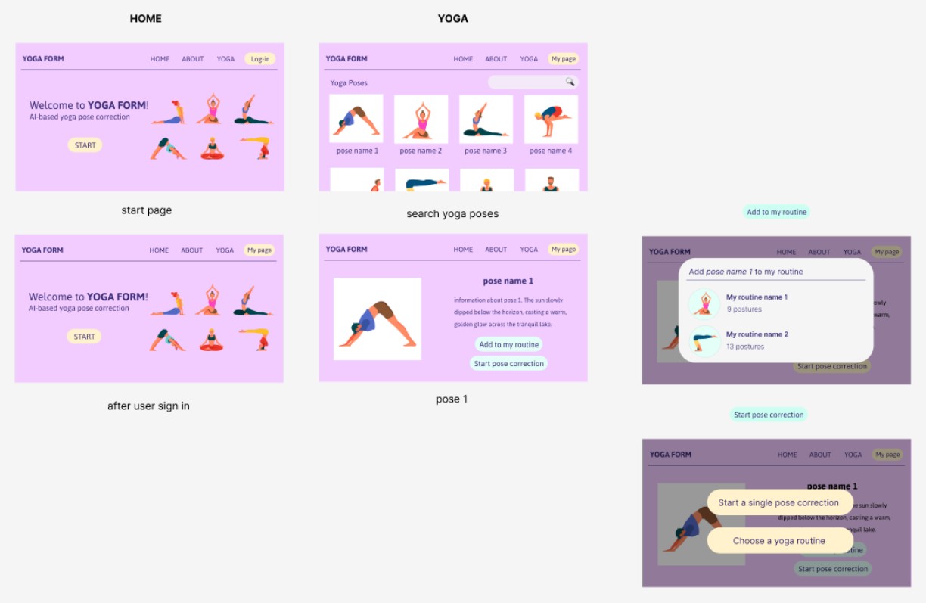

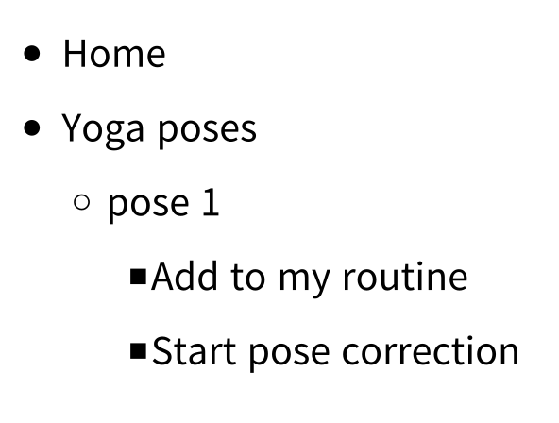
Notes:
We were able to make general UI’UX of our webpage.
I don’t know how this color would look like to you but it’s the color of lavender.
Our representative color is lavender, because this flower is known to be helpful for meditation and relaxing.
This is our home page, and you can use all of our service after you login.
If you click tab yoga, there, you can see all the poses we have.
You can click on each of it and save it to your custum routine.
If you want to do a single pose estimation of that pose, you can do that too.

Slide 7
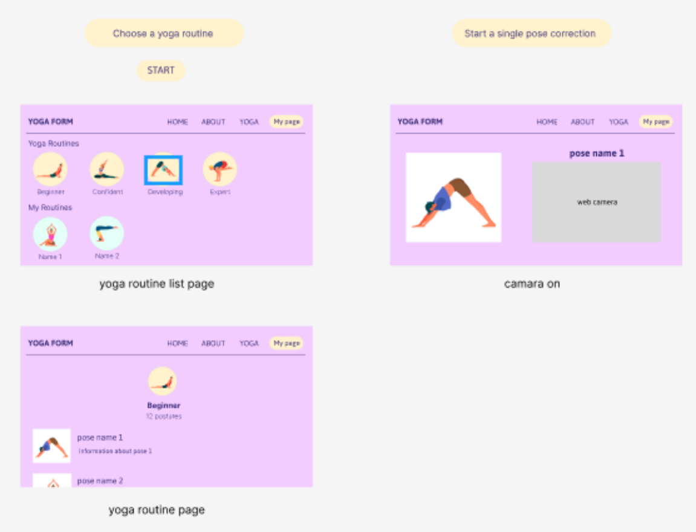
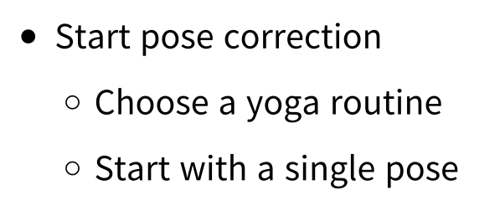
Notes:
If you click the start button, you can choose routine you would like to do.
We are planning to provide at least 2 levels.
And below that, you can see your own routines.
After you choose, then webcamera would be connected and the pose picture shown beside.

Slide 8
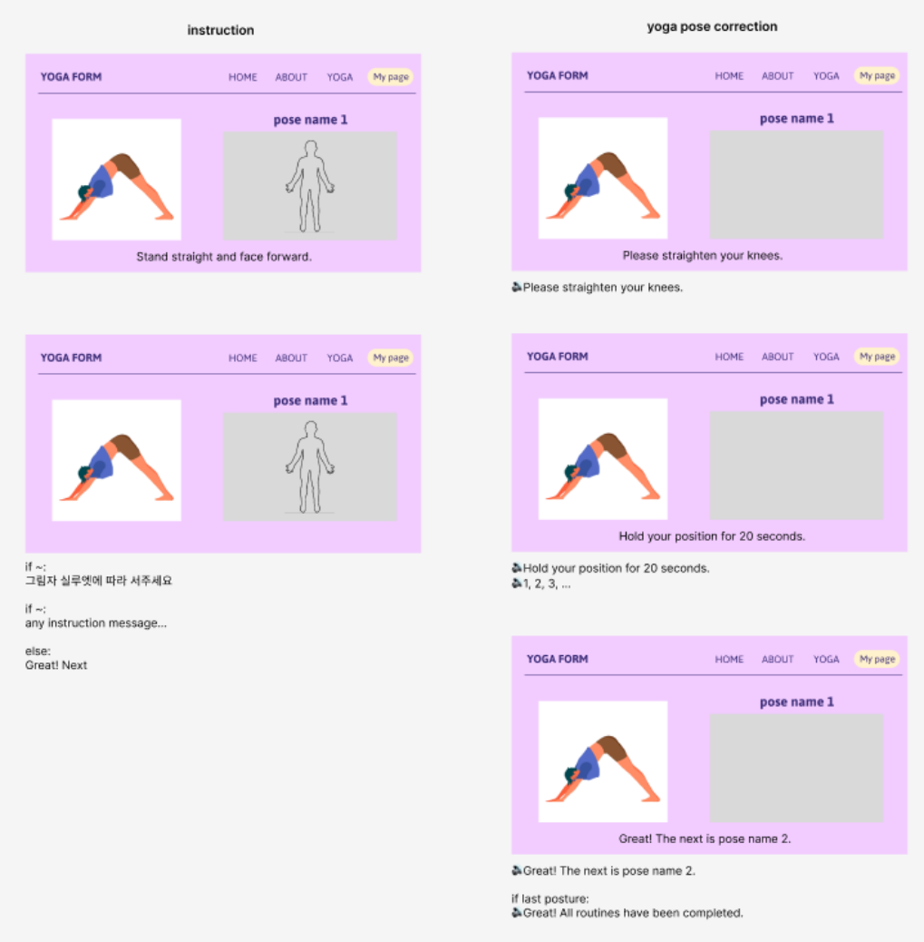
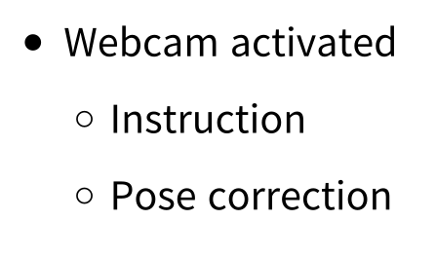
Notes:
This is the structure of page during routine.
Pose instruction on one side and your web camera on the other.
You will get endless feedback by our pose estimation AI based yoga coach function.
As many people concerned about different angle, we managed that problem by guide picture like this.
When user starts the routine, there will be pre setting instruction.
For example, your arms and legs should be recognized to start the yoga.

Slide 9








Notes:
Now I’ll explain about our technical part.
The frameworks and environment we’re using is mainly these three. We are using reactboot, react on the framework and springboot on the backend.
We are also using server instance of aws.

Slide 10

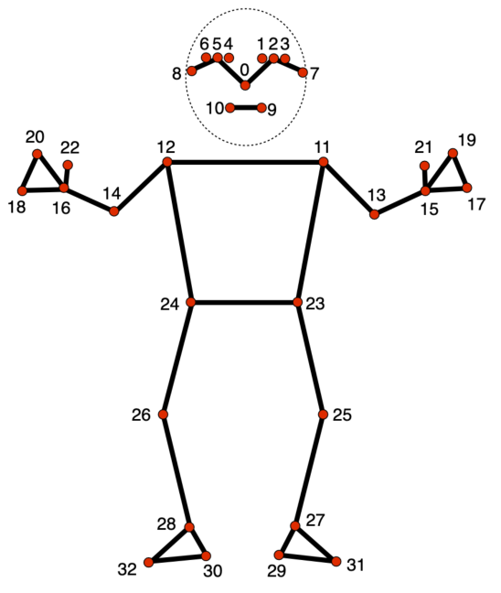
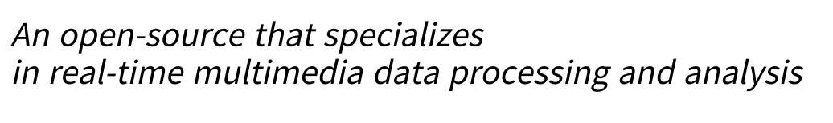
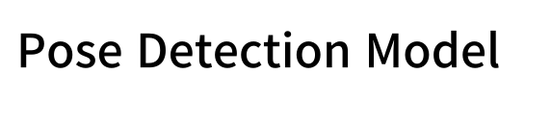
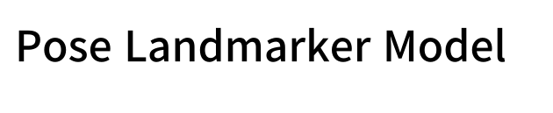
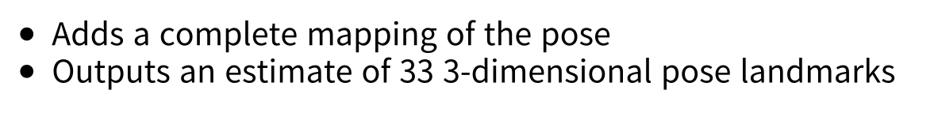
Notes:
Our main function requires pose estimation model. As we mentioned previously, we are using the mediapipe by Google.
It’s an open source that specializes in real-time multimedia data processing and analysis.
It consists of two models, pose detection and pose landmarker.
Pose detection model literaly detects the presence of bodies.
We utilized detection-related function a lot, because we also had to check whether the user is being recognized before start.
Then pose landmarker model follows, which adds a complete mapping of the pose. It outputs an estimate of 33 3-d pose landmarks.
We are using this landmarks when calculationg joint angles.

Slide 11

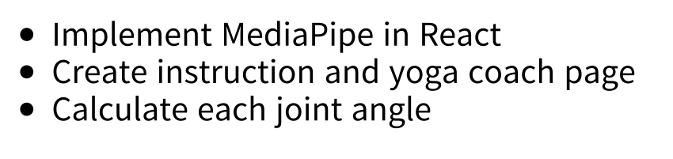

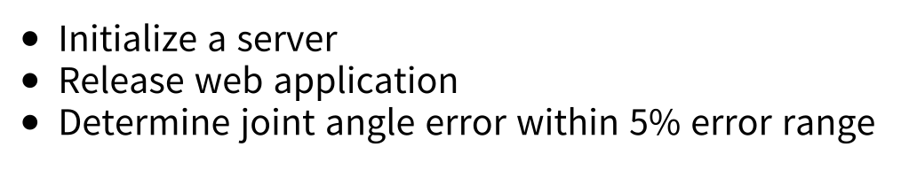
Notes:
On frontend, we implemented mediapipe in react successfully, so we can get the pose landmarks easily.
We created base pages like homepage, instruction and yoga coach page, and implemented calculation functions.
Moreover we managed to apply UI design on our pages.
On backend, we initialized a server instance. We could install larger and faster one thanks to the support fund.
We built spring backend project and checked that we can release combinig react and spring.
About angle checking, frontend calculate the angles and the value of it is sent to the backend.
Backend is responsible for checking it’s correctness within 5% error range, and we made it roughly.

Slide 12


Notes:
I’m sure it’s really hard to understand other’s project by some slides, so we made the demo video.
We recorded the whole webpage we built so far.
We set that the face and elbow should be recognized.
Then we can start doing yoga.
When you move you can see very busy console on the backend. We are sending angle each frame right now, so we’ll adjust it afterwards.
You can see that it shows whether your arm is correctly posed or not.
This was our short demo video.

Slide 13

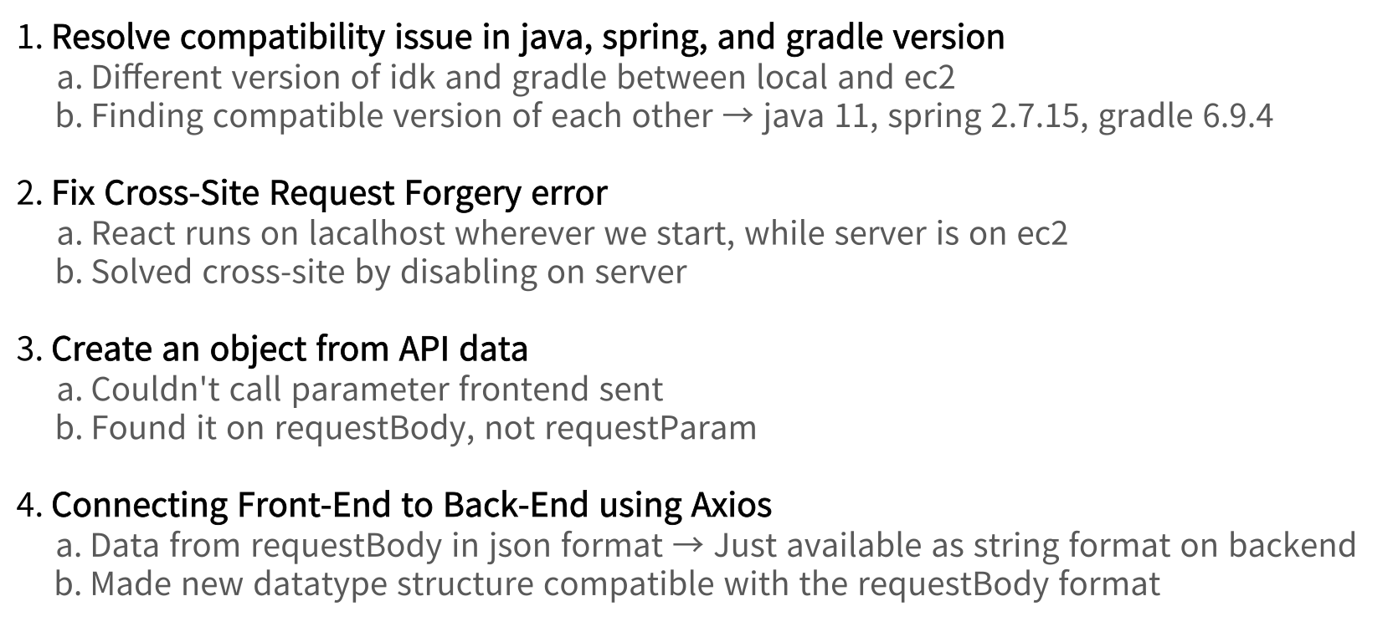
Notes:
We faced several challenges so far. We listed some of it.
First was resolving compatibility issue in java, spring, and gradle version.
At first I built spring project on my local and cloned it on the instance. But it kept producing error and it took some time to realize the verision difference.
Moreover, there were specific version set, like compatable version set of them. After a lot of trial we managed to build spring project as shown.
Then when frontend and backend tried to send data to each other, we got 403 forbidden error.
We thought it was CORS error but after handling it it didn’t work.
Besides, whereever we run react project, it kept starting on localhost, so we had to fix this problem.
Then we found about CSRF error, and able to handle this problem.
After network problem came receiving problem..
We sent the angle value in parameters but backend kept repeating that it’s null.
After changing it to find it in requestBody, we could solve it.
Surprisingly this wasn’t the end of receiving issue.
Data backend got was in JSON format but was available to get as String format.
Then we made new data structure compatible with it but we couldn’t fix it till we implemented override function of toString function.

Slide 14

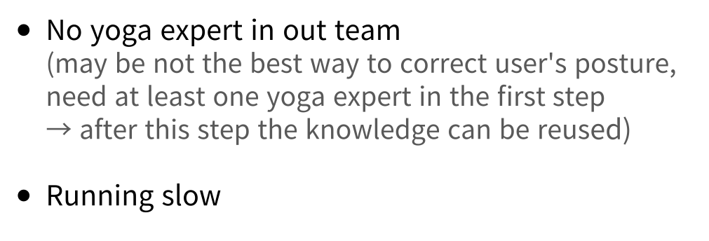

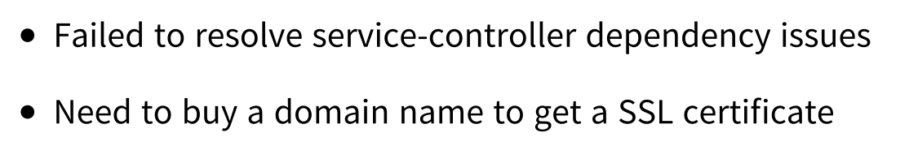

Slide 15

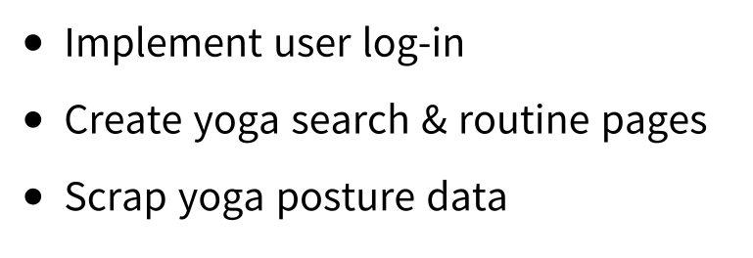

Slide 16
